Slide 1
Sum Product Networks Application For Medical Data
Presentation By
Tushar Karumudi
Prajay Jaya Shetty

Slide 2
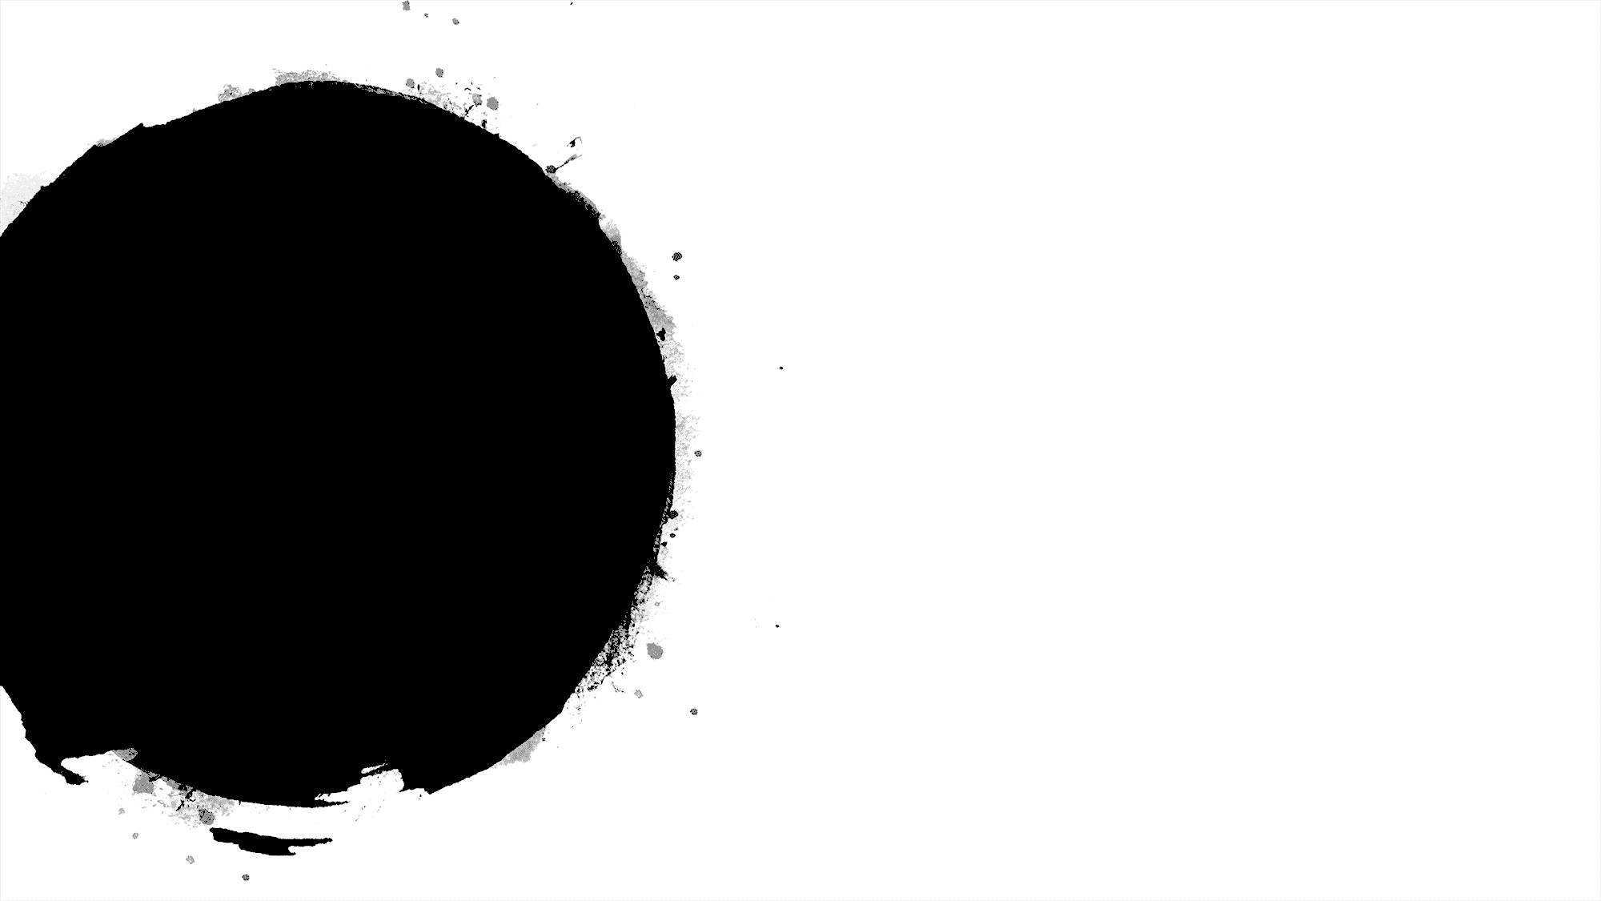
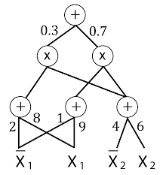
What is Sum Product Networks
Acyclic directed graph of sums and products
Leaves can be indicator variables or univariate distribution

Slide 3
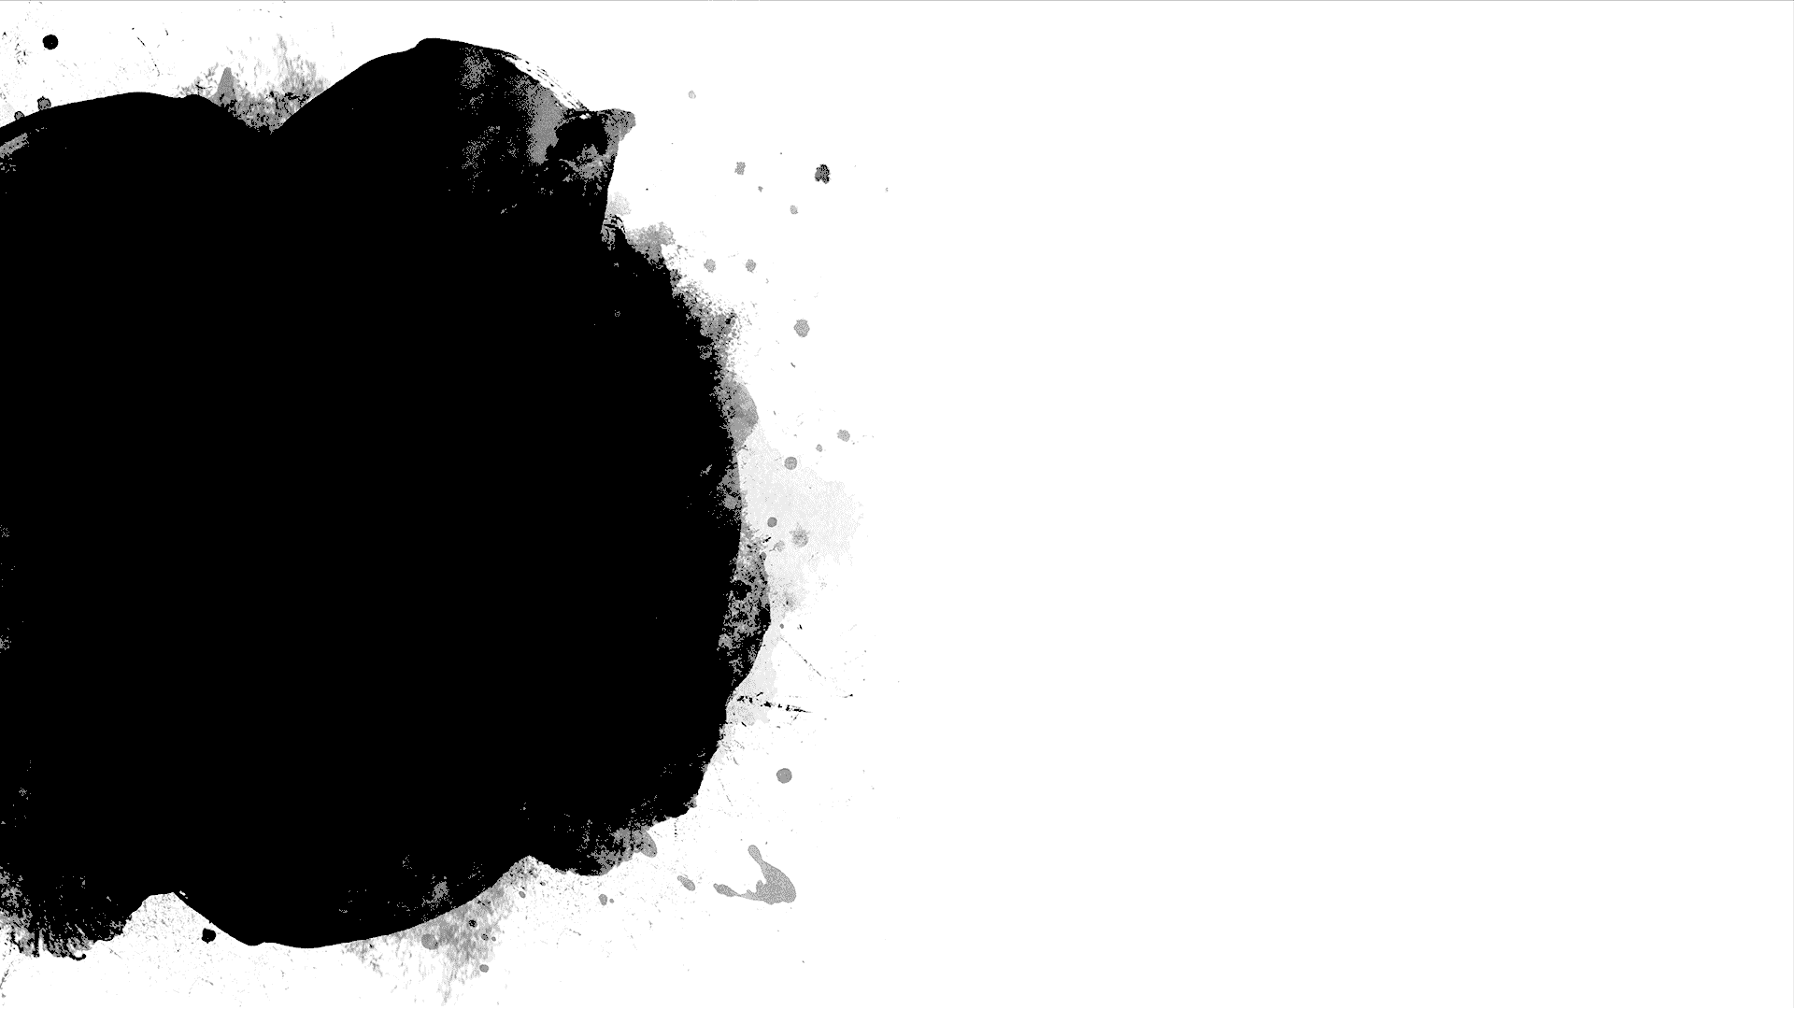
Two Views
Deep Architecture with clear Semantics
Tractable Probabilistic graphical model
Notes:
This can be seen as an alternative or similar to graphical models like bayasian networks or markov networks

Slide 4
Deep Architecture
Specific Type of neural network
Activation Function: Product
Advantage
Clear Semantics and well understood theory
Notes:
Obvious as deep neural network like we have different functions that are applied and then we have input and take weighted combinations of the inputs and then we have an activation function which is typically non linear, in this case if we view the product as activation, If we assume some wieghts once we feed the weights to the product we get a non liner function which is neural network with specific case of products and sum. The advantage of using it is, types on nn if we use sigmod , rectified linear functions good results or they have exprecivity but harder to interpret, this is simple as we have clear semantics.

Slide 5
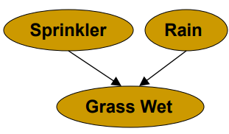
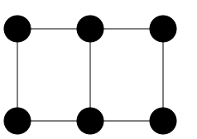
Probabilistic Graphical Models
Bayesian
Networks
Graphical View of direct dependencies
Inference
#p intractable
Markov Network
Graphical view of correlations
Inference
#P: intractable
Sum-Product Network
Graphical view of Computation
Inference
P: tractable

Slide 6
Probabilistic Inference
SPN represents a joint distribution over a set of random variables
Example :
Pr(X1=true,X2=false)

Slide 7
Semantics
A Valid SPN encodes a hierarchical mixture of distribution
Sum Nodes: hidden Variables (mixture)
Product Nodes : factorization (independance)

Slide 8
Definitions
The scope of a node is the set of variables that appear in the sub-SPN rooted at the node
An SPN is Consistent when each product node has children with disjoint scopes
An SPN is complete when the sum node has children with identical scopes
A consistent and complete SPN is a valid SPN

Slide 9
Parameter Estimation
Instances
Parameter Learning: estimate the weights
Expectation-Maximization, Gradient descent
Data
+
*
*
Attributes
+
+
+
X1
X1
X2
X2

Slide 10
Structure Estimation
Alternate Between
Data Clustering: Sum Nodes
Variable partitioning: Product Nodes

Slide 11
Relationship with Bayes Networks
Any SPN can be converted into Biparte Bayesian network
H
X1
X2

Slide 12
Normal SPN
An SPN is normal when
It is consistent and complete
All weights are non-negative.
Every terminal node in the SPN is a univariate distribution and the size of scope of each sum node is at least 2

Slide 13
Inferences
Deep SPN can be converted into shallow BNs
The depth of an SPN is proportional to the height of the highest decision diagram in the corresponding BN diagram

Slide 14
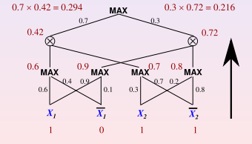
Computing Most Probable Explanation
We know that x1 = 1.
What value is most likely for x2?
Replace sum nodes by max nodes .
Evaluate SPN in a bottom up pass with x1 = 1, ¯x1 = 0, x2 = 1, ¯x2 = 1

Slide 15
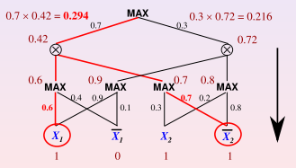
Computing Most Probable Explanation
In a top down pass, pick the child of a max node with highest value.
Pick always all the children of a product node.
The most likely value for x2 is 0.

Slide 16
Basic Equation Understanding Demo

Slide 17
Project Demo
Dataset : PIMA Indian diabetics dataset of 786 Patients
Application of SPN on this dataset

Slide 18


